Slide 1



Cognitive Customer Engagement
CCE Chat Platform
Jan 2020
Anju Chopra

Slide 2



Cognitive Customer Engagement
C C E
CCE is an extensible software platform that imparts cognitive capabilities and intelligent automation to customer interaction and client’s business processes using multiple communication channels by seamlessly integrating client’s front and back office systems and business workflow.

Slide 3
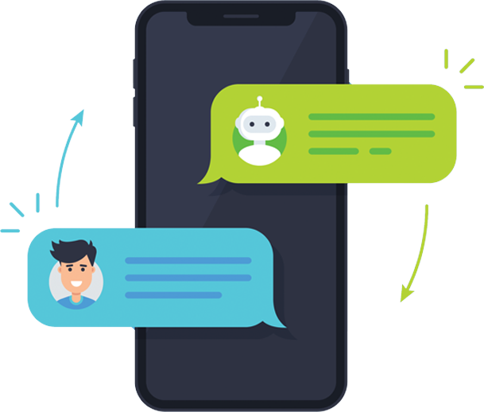
CCE Chat Platform
CCE Chat Platform provide a complete solution that allows users to communicate in real time using easily accessible web and mobile user interfaces.
The CCE Chat platform has a rich feature set and includes file sharing, message translation, and many more features. Designed to help entire organizations, teams, or individuals to communicate with one another in a group or one-to-one environment. It allows you to chat directly with your website visitors. Chatbot allows users to collaborate and communicate from wherever they are.

Slide 4
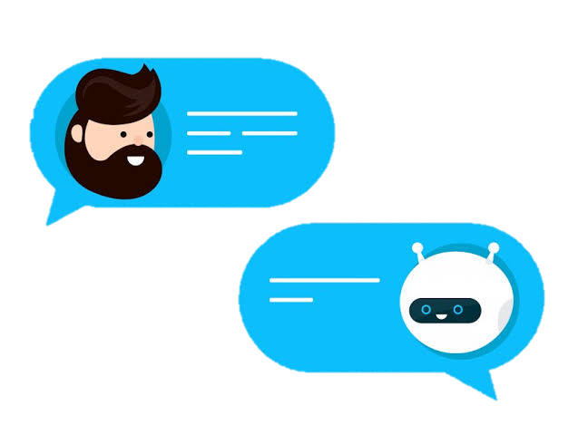
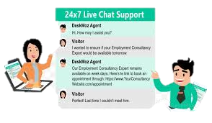


CCE BOT’s
01
Multilingual FAQ Bots
CCE Chat Platform provides an Extensible and Scalable Chat Engine, BOTs and Framework for following communication channels:
- Customer to Bot Chat
- Customer to Live Agent Chat
Agent to Agent Chat
CCE Bots has capability to integrate with other applications such as IVR, What’s App & SME. Integrations that every enterprise would need
02
VoiceBot
03
What’s App Integration
04
SMS Integration
4

Slide 5
Deployment Dependencies
Scope | Prerequisites | UAT | Go Live
Multilingual FAQ Bot Up to 50 intents/FAQ configuration | No integration InfoSec Approvals Intents/FAQ availability | 1 week | Post UAT 2 days, ECR required for CNX shared infra deployment
Voicebot Up to 50 intents/FAQ configuration | Support from IVR team to configure IVR on Avaya Support from voice team to provide PSTN number for voice bot InfoSec Approvals | 1 Week for Configuration of Bot Logic , Additional time for IVR application integration and telephony infra needs to be added | Post UAT 2 days, ECR required for CNX shared infra deployment
WhatsApp integration Up to 50 intents/FAQ configuration | WhatsApp Business account/number to be provided by client InfoSec Approvals | 1 Week | Post UAT 2 days, ECR required for CNX shared infra deployment
SMS integration | SMS API availability InfoSec Approvals | 1 Week | Post UAT 2 days, ECR required for CNX shared infra deployment

Slide 6

Multilingual FAQ Bot : Dependencies
01
Deliverable for 1 week
- Up to 50 intents/FAQ configuration & delivery for UAT in a week
02
No Integration Required
- No integration to any client systems considered in scope
Web based text chat widget
- Available on web based text chat widget Integrateable on any website using 10 lines on JavaScript code provided by us
03
04
PSTN Voice Channel
- Available on PSTN voice channel
CCE
Multilingual FAQ Bots
05
WhatsApp Channel
- Available on WhatsApp channel
- Chatbot can support over 100 languages based on machine translation. (See this link for list of languages https://cloud.google.com/translate/docs/languages)
06
Multilingual
07
Real Time Translation
- Live agent real time translation text chat bot

Slide 7
Voice Bot : Deployment Dependencies
IVR Integration
Support from IVR team to configure IVR on Avaya
PSTN Number
Support from voice team to provide PSTN number for voice bot
Languages Support
Voicebot support over 30 languages. (Refer linkhttps://cloud.google.com/text-to-speech/docs/voices, https://cloud.google.com/speech-to-text/docs/languages)

Slide 8
WhatsApp integration: Deployment Dependencies
WhatsApp Business account/number to be provided by client
SMS integration: Deployment Dependencies
SMS API availability from Deepak KL’s team

Slide 9
Thank you……

